Slide 1


Jacqueline Ivette Torres
06/11/2024

Slide 2

Outline
Executive Summary
Introduction
Methodology
Results
Conclusion
Appendix

Slide 3
Executive Summary
Summary of methodologies
Data Collection Through API
Data Collection with Scraping
Data Wrangling
Exploratory Data Analysis using SQL
Exploratory Analysis Using Pandas and Matplotlib
Interactive Visual Analytics and Dashboard
Machine Learning Predictive Analysis
Summary of all results
Exploratory Data Analysis results
Interactive Analytics
Predictive Analytics Results

Slide 4
Introduction
The main goal in this project is to predict if the Falcon 9 first stage will land successfully. The Company SpaceX advertised launches with a cost of 62 million dollars lower than other providers that offered launches with a cost of 165 million dollars. SpaceX can save more because they are planning to reused the first stage of a rocket launch. If we can determine the success in the landing, we can also determine the cost of a launch, so this information can be used to bid against SpaceX by an alternate company.
The main question that we have to answer is which factors can influence the landing outcome and to find the best condition to have a successfully Landing.

Slide 5

Section 1

Slide 6
Methodology
Executive Summary
Data collection was carried out through two methods: requesting data from the SpaceX API and Web Scraping launch data from a Wikipedia page.
Data wrangling was performed to transform and clean data using Python’s pandas library.
Exploratory data analysis (EDA) was perform using visualization tools and answering question with SQL queries.
Interactive visual analytics packages from Python were used to answer some analytical question. Folium was used for creating maps and also interactive data visualization using Plotly Dash.
Four different machine learning models were used for predictive analysis. The models that were use were Logistic Regression, K-Nearest Neighbors, Support Vector Machines and Decision Tree. Each model was train tune and evaluated to find the most effective.

Slide 7
Data Collection – SpaceX API
GitHub URL: Data Collection API
Request and parse the SpaceX launch using GET request
Normalize JSON response into a data frame
Extract only useful columns using auxiliary functions
Create new Pandas data frame from dictionary
Filter Data frame to obtain only launches Falcon 9
Dealing with missing values
Export data Falcon 9 to a CSV file

Slide 8
Data Collection – Scraping
Request the SpaceX launch from Wikipedia using GET request
Extract all column/variable names from the HTML table header
Create a data frame by parsing the launch HTML tables
Export to csv file
GitHub URL: Data Collection with Web Scraping

Slide 9
Data Wrangling
GitHub Exploratory Data Analysis
Calculate the number of launches on each site
Calculate the number and occurrence of each orbit
Calculate the number and occurrence of mission outcome per orbit type
Create a landing outcome label from Outcome column usin one-hot encoding.
Export to csv file

Slide 10
EDA with Data Visualization
Scatter plots: were used to represent the relationship between two variables. Were used to compared Flight Number vs. Launch Site, Payload vs. Launch Site, Flight Number vs. Orbit Type and Payload vs. Orbit Type.
Bar chart: Bar charts were used makes it easy to compare values between multiple groups at a glance. The x-axis represents a category and the y-axis represents a discrete value. Bar charts were used to compare the Success Rate for different Orbit Types
Line chart: Line charts are useful to show data trends over time. A line chart was used to show Success Rate over a certain number of Years.
GituHub URL:EDA with Data Visualization

Slide 11
EDA with SQL
Display the names of the unique launch sites in the space mission
Display 5 records where launch sites begin with the string 'CCA’
Display the total payload mass carried by boosters launched by NASA (CRS)
Display average payload mass carried by booster version F9 v1.1
List the date when the first successful landing outcome in ground pad was achieved.
List the names of the boosters which have success in drone ship and have payload mass greater than 4000 but less than 6000
List the total number of successful and failure mission outcomes
List the names of the booster versions which have carried the maximum payload mass. Use a subquery
List the records which will display the month names, failure landing outcomes in drone ship ,booster versions, launch site for the months in year 2015.
Rank the count of landing outcomes (such as Failure (drone ship) or Success (ground pad)) between the date 2010-06-04 and 2017-03-20, in descending order.
GitHub URL: EDA with SQL

Slide 12
Build an Interactive Map with Folium
Objects were created and added to a Folium map. Marker objects were used to show all launch sites on a map as well as the successful/failed launches for each site on the map. Line objects were used to calculate the distances between a launch site to its proximities
By adding these objects, following geographical patterns about launch sites are found:
Are launch sites in close proximity to railways? Yes
Are launch sites in close proximity to highways? Yes
Are launch sites in close proximity to coastline? Yes
Do launch sites keep certain distance away from cities? Yes
GitHub URL: Interactive Map Analytics with Folium

Slide 13
Build a Dashboard with Plotly Dash
The dashboard application contains two charts:
A pie chart that shows the successful launch by each site. This chart is useful as you can visualize the distribution of landing outcomes across all launch sites or show the success rate of launches on individual sites.
A scatter chart that shows the relationship between landing outcomes an the payload mass of different boosters. The dashboard takes two inputs, namely the site(s) and payload mass. This chart is useful as you can visualize how different variables affect the landing outcomes,
GitHub URL:Space X Dashboard

Slide 14
Predictive Analysis (Classification)
Create a NumPy array from the column Class
Standardizing de data using transform
Split into training and test set
Find the best Hyperparameters for Logistic Regresion, SVM, KNN and Decisition tree
Use test data to evaluate models based on their accuracy score and confusion matrix.
GitHub URL: Space X Machine Learning Prediction

Slide 15
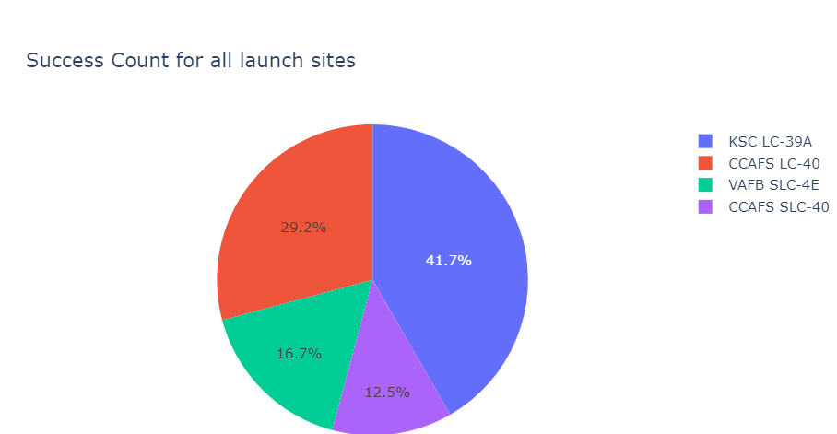
KSC LC-39A and VAFB SLC 4E has a success rate of 77%
Results
The results of de exploratory data analysis revealed that the launch site KSC LC-39A and VAFB SLC 4E has a success rate of 77% and CCAFS LC-40 the success rate of 60%.
The results for the interactive analysis shows that the launch site KSC LC-39A has the higher rate of success 41.7%
Predictive analysis results showed that three (LR,KNN,SVM) of the models tested had an accuracy of 83.33% and the Decision tree only has 77% of accuracy.

Slide 16

Section 2

Slide 17
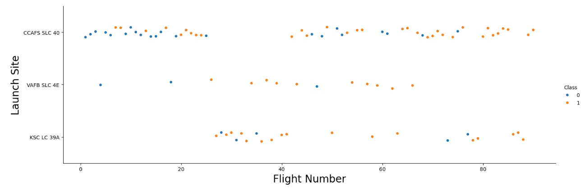
Flight Number vs. Launch Site
The orange dots represents the successful launches and the blue dots unsuccessful launches.
Successful launch increases after the 40th launch.
The success rate increased as the number of flights increased.

Slide 18
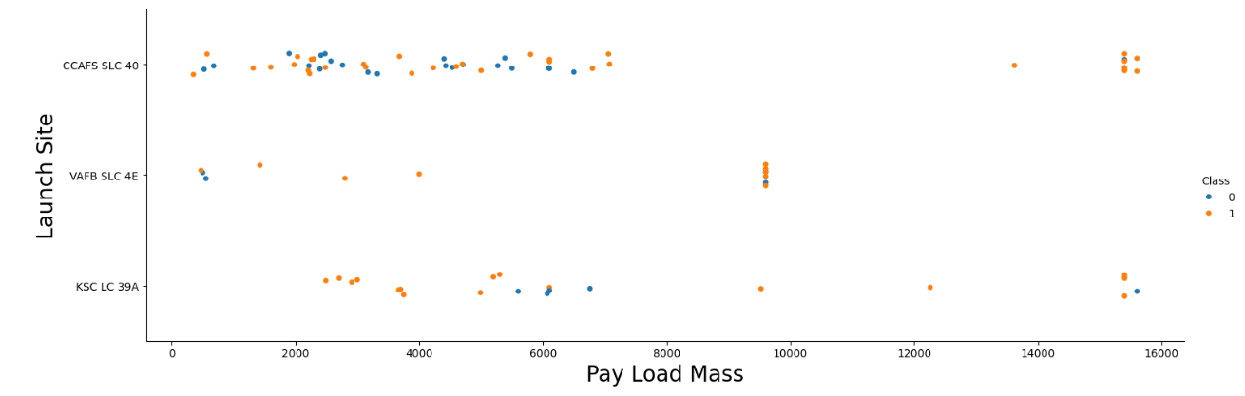
Payload vs. Launch Site
The orange dots represents the successful launches and the blue dots unsuccessful launches.
The VAFB-SLC launchsite there are no rockets launched for heavypayload mass (greater than 10000)
The correlation between Payload mass and Launch site is very week.

Slide 19
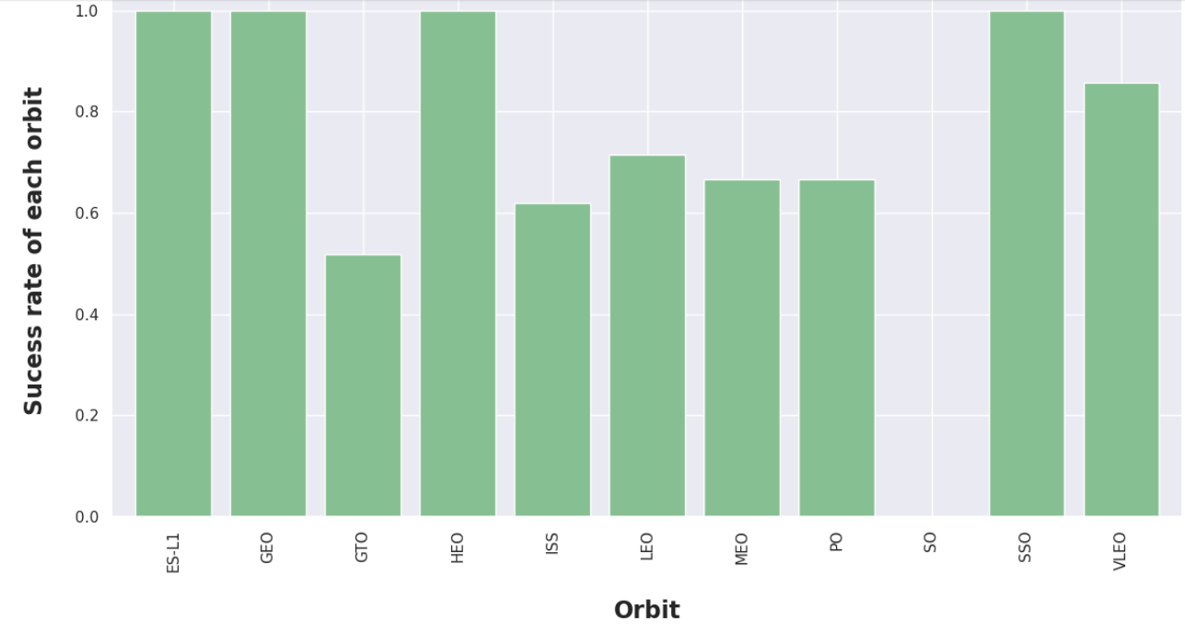
Success Rate vs. Orbit Type
The Orbit ES-L1,GEO,HEO,SSO have a 100% success rates.
The SO have 0% success rate.

Slide 20
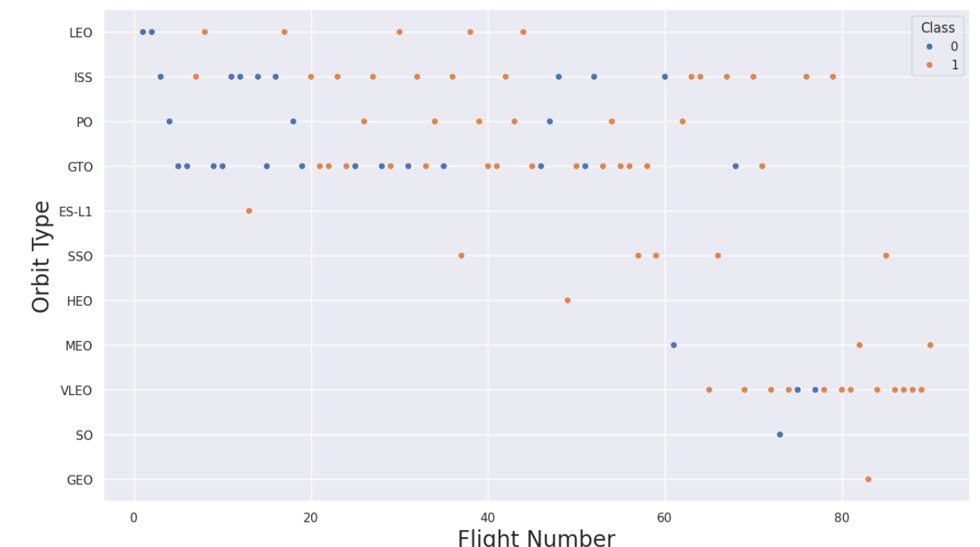
Flight Number vs. Orbit Type
In the LEO orbit, the success is positively correlated to the number of flights.
As the flight number increase the rate of success increase.
Orbits SO, GEO has a less number of flights.

Slide 21
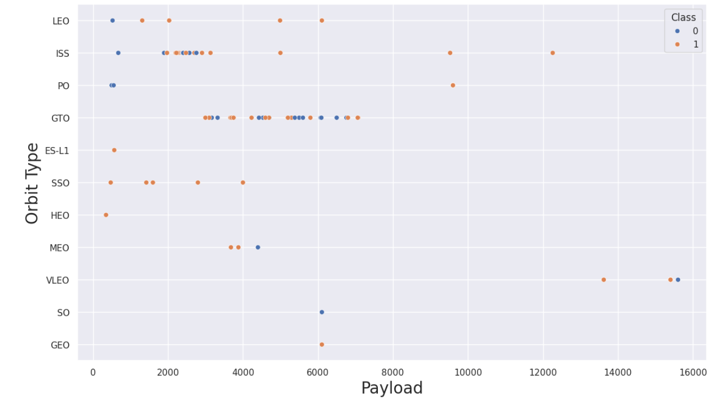
Payload vs. Orbit Type
Sso has 100% success rate with payload less than 4000.
As the payload is heavier the success rate increase in LEO and ISS orbit.

Slide 22
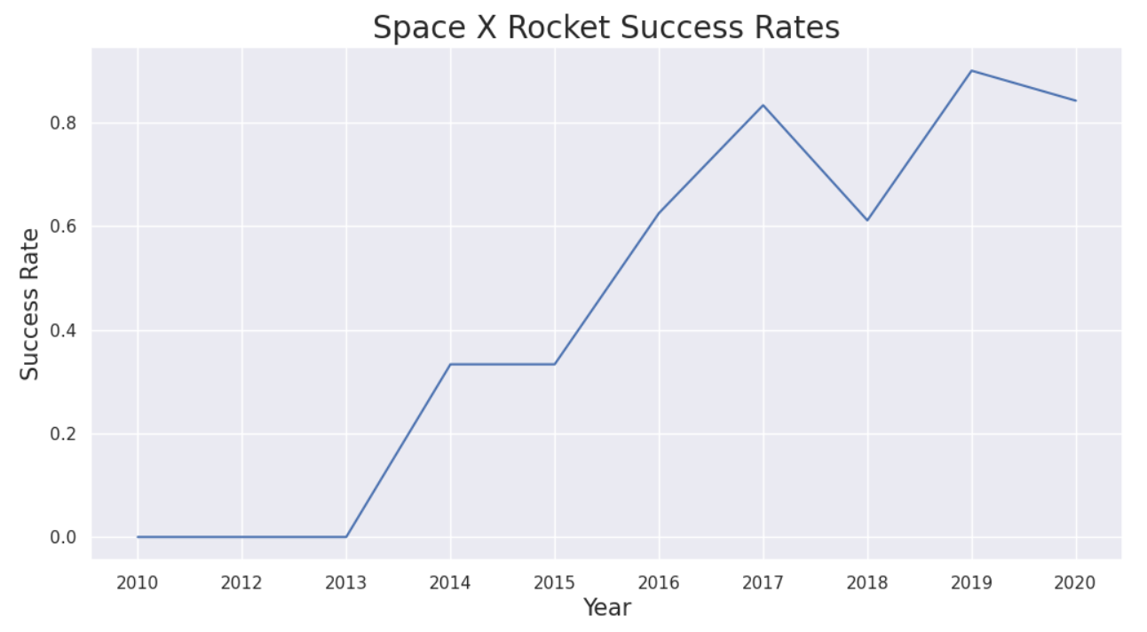
Launch Success Yearly Trend
The success rate increase through the years, only had a little decrease between 2017 and 2018, then go up again and a dip in 2020.

Slide 23
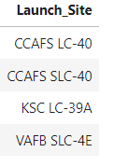
All Launch Site Names
To find the unique launch_site names a Unique clause was used with a group by from the launch_site column.
As a result we have the next Launch_site: CCAFS LC-40, CCAFS SLC-40, KSC LC-39A, VAFB SLC-4E

Slide 24
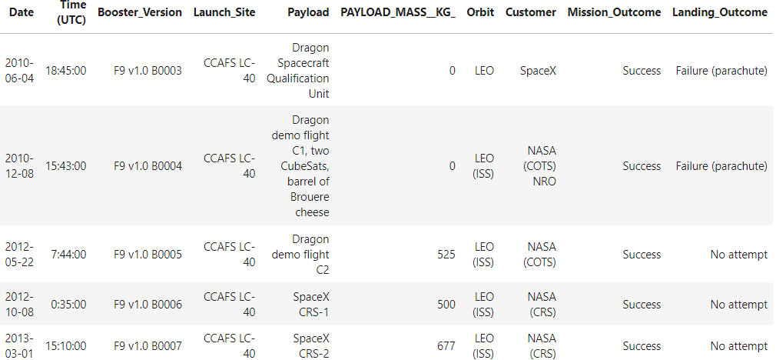
Launch Site Names Begin with 'CCA'
To find the record was used a LIKE clause in the condition where the name start with “CCA’
To get only 5 rows as is show was used LIMITE 5

Slide 25
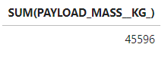
Total Payload Mass
To calculate the total payload carried by booster was used the function SUM() from the column payload_mass_kg

Slide 26
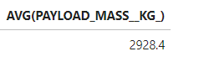
Average Payload Mass by F9 v1.1
To calculate the average payload mass carried by booster version F9 v1.1 was used the function AVG().
Was used a WHERE clause to obtain only the rows where the booster_version is “F9 v1.1”

Slide 27

First Successful Ground Landing Date
Was used a MIN(Date) function to find the first date of a successful landing.
A WHERE clause was used to ensure just data when the landing_outcome is “Success(ground pad)”

Slide 28
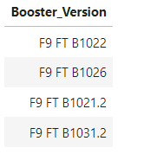
Successful Drone Ship Landing with Payload between 4000 and 6000
To obtain the List of Booster_version a WHERE clause was used filtering results to the data that the landing_outcome was drone ship and the payload between 4000 and 6000.

Slide 29
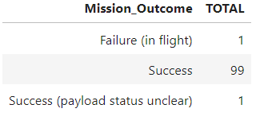
Total Number of Successful and Failure Mission Outcomes
To calculate the total of mission successful and failure outcomes a COUNT() function was used with a help of the GROUP BY class in the column mission_outcome.
There are 99 successful mission outcomes out of 101 missions.

Slide 30
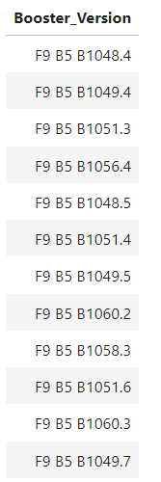
Boosters Carried Maximum Payload
A subquery was used in the WHERE clause to find the maximum payload mass with the MAX() function. The principal query list all the booster_version that have the maximum payload.

Slide 31
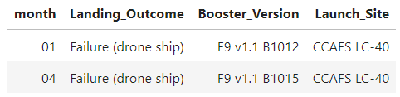
2015 Launch Records
List the failed landing_outcomes in drone ship where filtered using substr(Date,0,5) instead of the year because SQLLite doesn’t support that function.
The year was obtained substr(Date,0,5) and used in the WHERE clause to filter the information for 2015.

Slide 32
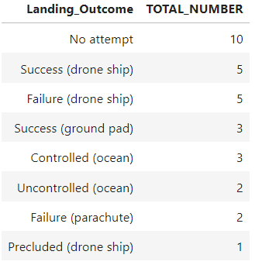
Rank Landing Outcomes Between 2010-06-04 and 2017-03-20
COUNT() function was used to count the different landing_outcomes. To filter the outcomes between to dates a WHERE clause was used to filter the date between 2010-06-04 and 2017-03-20. a GROUP BY was used to ensure that the count was grouped by the outcome and to show the results in descending order a ORDER BY DESC clause was used.

Slide 33

Section 3

Slide 34
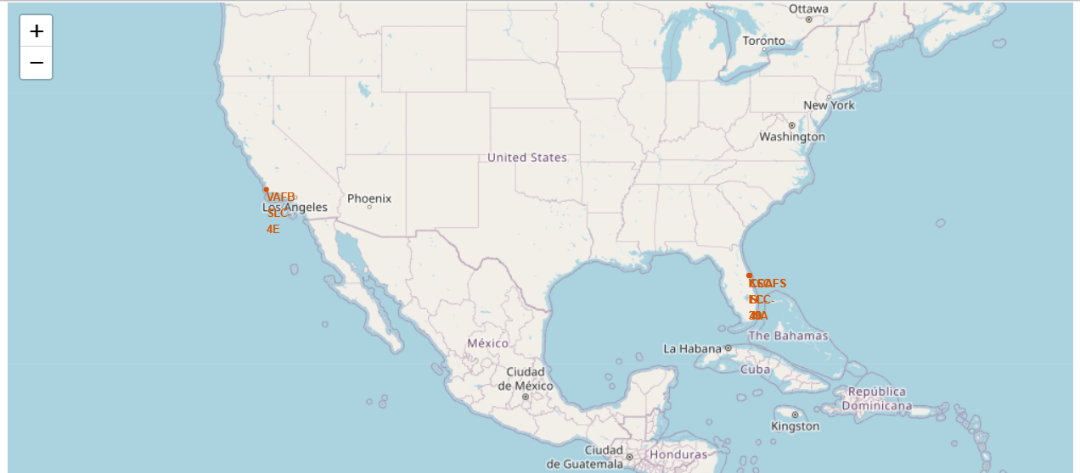
SpaceX Launch Sites Locations
Each marker represent where the Launch sites are located in the US.
The launch sites are located near the coast.

Slide 35
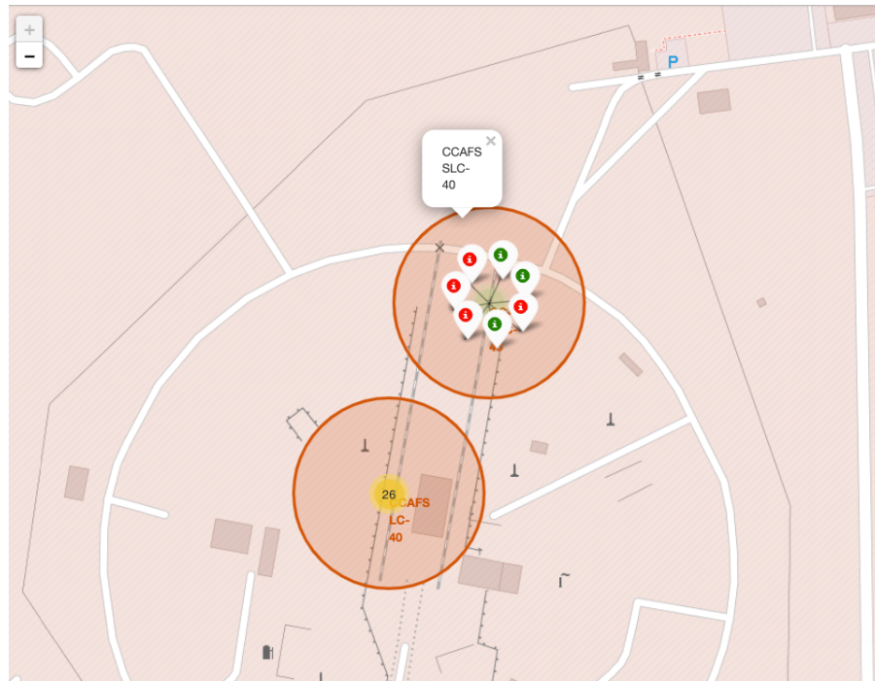
Successful or Failure launches
You can see the green point that represents the successful launch.
The red point represents the failures.

Slide 36
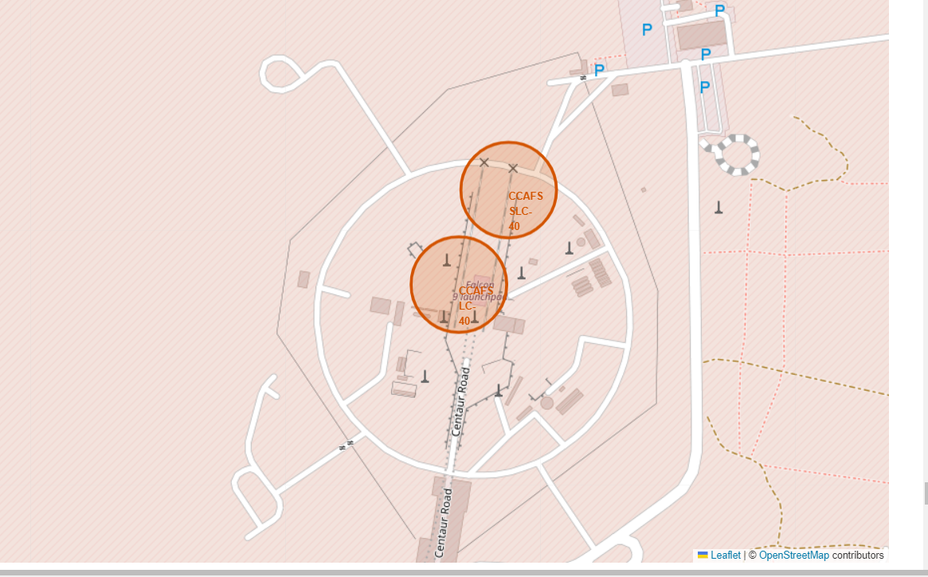
Launch Site Proximities
The generated map shows that the selected launch site is close to a highway for transportation of personnel and equipment. The launch site is also close to the coastlines for launch failure testing.
The launch sites also maintain a certain distance from the cities. (Can be viewed in notebook).

Slide 37

Section 4

Slide 38
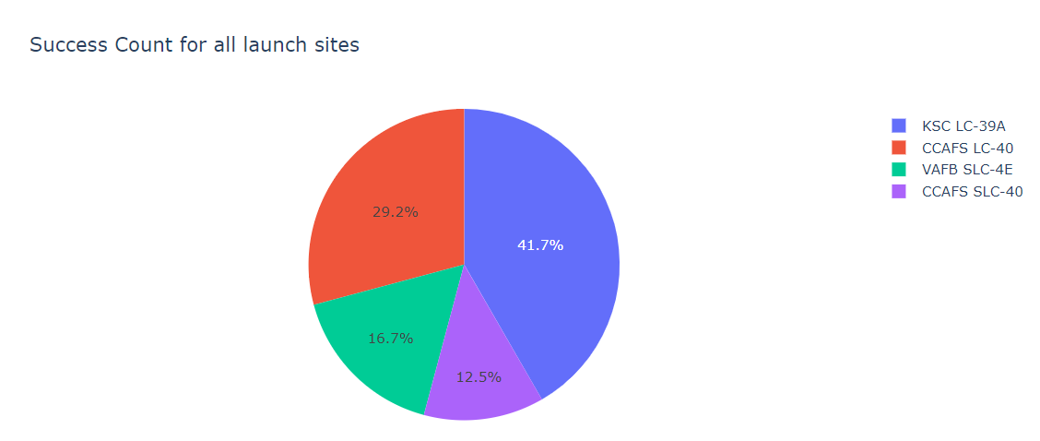
Total Successful Launches By Site
According to the graphic the launch site most successful is the KSC LC-39A

Slide 39
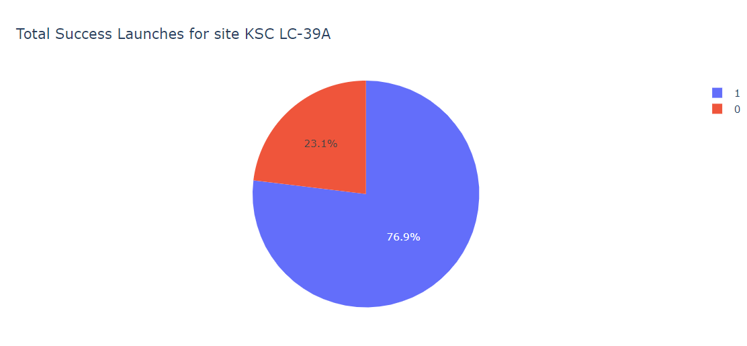
Launch Site Success Rate
The success rate for the KSC LC-39A is 76.9%

Slide 40
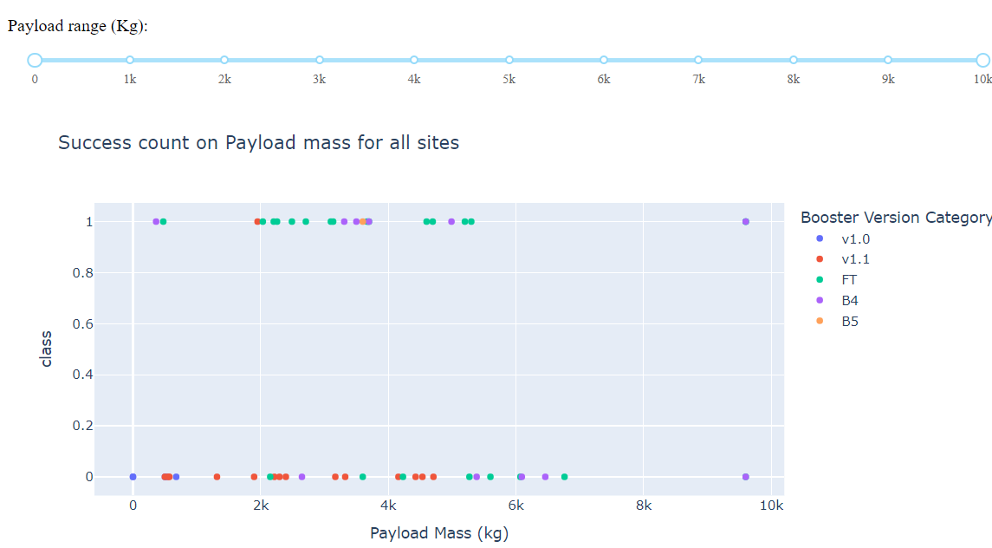
<Dashboard Screenshot 3>
The Bosster V1.1 has the most success rate in payloads between 0 and 5000kg.

Slide 41

Section 5

Slide 42
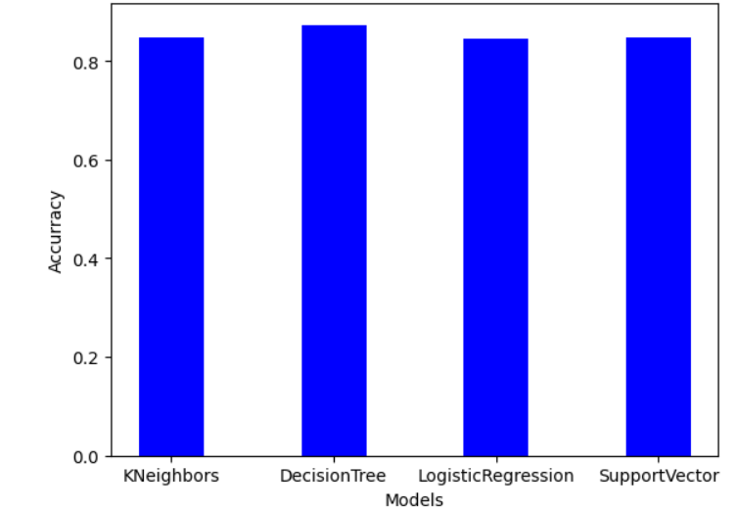
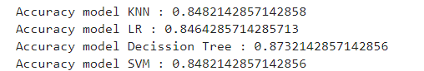
Classification Accuracy
The Decision Tree has the highest accuracy 87% against the other models that only have the 84% of accuracy.

Slide 43
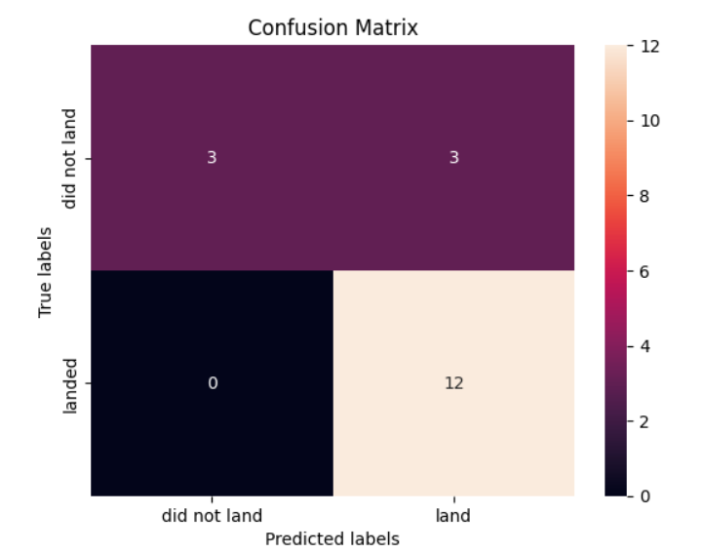
Confusion Matrix
The model predicted successful landings.
The model predicted 12 successful landing with true label positive (landed) and 3 successful when the true label was negative (did no land).
The model also predicted 3 unsuccessful landing when true label negative(did not land)

Slide 44
Conclusions
The analysis showed that there is a positive correlation between number of flights and success rate as the success rate has improved over the years.
There are certain orbits like SSO, HEO, GEO, and ES-L1 where launches were the most successful.
Success rate can be linked to payload mass as the lighter payloads generally proved to be more successful than the heavier payloads.
The launch sites are strategically located near highways and railways for transportation of personel and cargo, but also far away from cities for safety.
The best predictive model to use for this dataset is the Decision Tree Classifier as it had the highest accuracy with 87%.

Slide 45
Appendix
Git HUB Repository: https://github.com/IviTorres/DataScienceCapstone

Slide 46


